Slide 1


Classes
Part 4 – Miscellaneous

Slide 2

this

Slide 3
When two instances of the same class are created two chunks of memory are set aside to hold the object’s data members. The executable code associated with defined class methods is stored separately. Only one instance of the executable code is held in memory and used by all instances of that class.
How do invoked methods know which object (address in memory) they should manipulate?
1 | class Foo
2 | { int dat; void doWork() };
3 | Foo *a = new Foo;
4 | Foo *b = new Foo;
Machine instructions for Foo’s methods
a’s data members
b’s data members
Code
Static
Heap
Free memory
Stack
Notes:
When two instances of the same class are created two chunks of memory are set aside to hold the object’s data members.
The executable code associated with defined class methods is stored separately (within the block of memory set aside to hold the machine instructions). Only one instance of the executable code is held in memory and used by all instances of that class.
How do invoked methods know which object (address in memory) they should manipulate?

Slide 4

This can be done by passing the address of the object (data members) to the function (using a somewhat hidden argument).
In particular, anytime a non-static class member is called, a special pointer is created as a hidden argument to that method which identifies the object the method should manipulated.
This is the this pointer.
Although it’s not usually necessary to do so, the this pointer can be used explicitly.
this can be useful in certain instances (e.g. copy constructors, etc.) to more clearly identify the object that is being modified.
Notes:
This can be accomplished by passing the address of the object (strictly the object’s data members) to the function. This is done using a (somewhat) hidden argument.
In particular, anytime a nonstatic class member is called, a special pointer is created as a hidden argument to that method which identifies the object the method should manipulated.
This is the this pointer.
Although it’s not usually necessary to do so, the address in the this pointer can be used explicitly in the called method.
This can be useful in certain instances (e.g. copy constructors, etc.) to more clearly identify the object that is being modified.

Slide 5
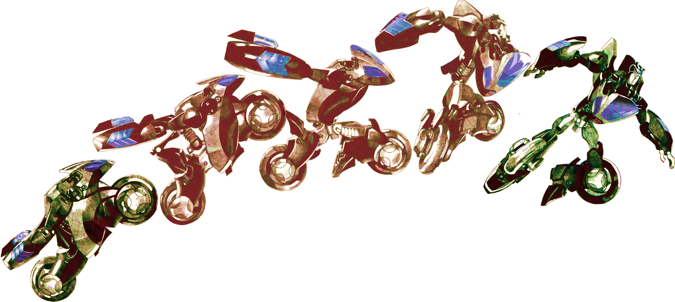
Casting
Transforming Data

Slide 6
Now that we’ve explored classes, the four types of casting introduced with C++11 are further explored.
C++11 Casts
static_cast<type>(arg)
const_cast<type>(arg)
dynamic_cast<type>(arg)
reinterpret_cast<type>(arg)

Slide 7

: Const-Cast
const_cast can be use to cast away the const-ness of a variable.
1 | void foo(char* data) {}
2
3 | const char *name = "...";
4
5 | foo(name); // Will not compile
6 | foo(const_cast<char*>(name)); // OK
This cast should only be used with dealing with third-party code where you know the function will not change the data but this is not reflected in a poorly defined definition. Otherwise, const_cast should be avoided.
Notes:
const_cast can be use to cast away the const-ness of a variable.
void foo(int* data, int size) // Accepts a mutable int array
{ }
const char *name = "...";
foo(name); // Will not compile
foo(const_cast<char*>(name)); // OK

Slide 8
: Static-Cast
1 | class A
2 | {
3 | public:
4 | A() {}
5 | };
1 | class B
2 | {
3 | public:
4 | B() {}
5 | B(A a) {}
6 | };
You can use static_cast to perform type conversions that are ‘legally’ supported by C++.
This includes built-in conversion between primitive data types (bool to int, int to float, etc.). It also includes user defined classes where there exists a suitable constructor.
In most situations the compiler will perform the conversion automatically.
1 | void fooA(A a) {}
2 | void fooB(B b) {}
1 | A a;
2 | B b;
3
4 | fooA(b); // Error
5 | fooA(static_cast<A>(b)); // Error
6
7 | fooB(static_cast<B>(a)); // OK
8 | fooB(a); // OK - implicit
Notes:
You can use static_cast to perform type conversions that are ‘legally’ supported by C++.
This includes build in conversions between primitive data types (bool to int, int to float, etc.). It also includes user defined classes where there exists a suitable constructor.
In most situations the compiler will perform the conversion automatically.

Slide 9

: Static-Cast
static_cast will also perform up/downcasts within an inheritance hierarchy.
Importantly - static_cast does not perform runtime type checking (they are tested at compile time).
As such downcasts within an inheritance hierarchy (from base class to derived class) are untested at runtime (i.e. dangerous).
Notes:
You can use static_cast to perform type conversions that are ‘legally’ supported by C++.
This includes build in conversions between primitive data types (bool to int, int to float, etc.). It also includes user defined classes where there exists a suitable constructor.
In most situations the compiler will perform the conversion automatically.

Slide 10

: Dynamic-Cast
dynamic_cast provides a run-time check on casts within an inheritance hierarchy.
For invalid casts a value of NULL is returned (if casting a pointer) or a std::bad_cast exception thrown (if casting a reference).
1 | class Base { };
2 | class Derived : Base { };
1 | Base *b = new Base;
2 | Derived *d = dynamic_cast<Derived*>(b);
3 | if( d != NULL )
4 | { }
5
6 | Base base;
7 | Base &br = base;
8 | try {
9 | Derived &dr = dynamic_cast<Derived&>(br);
10 | } catch (std::bad_cast&) { }
Notes:
dynamic_cast provides a run-time check on casts within an inheritance hierarchy. It can be used to cast pointers or references.
For invalid casts a value of NULL is returned (if casting a pointer) or a bad_cast exception thrown (if casting a reference).
Note that the runtime-type information is stored in the vtable of the object. In order to use
dynamic_cast, the classes must have at least one virtual function.

Slide 11

: Reinterpret_Cast
reinterpret_cast can be used to perform casts that are otherwise not technically allowed in C++
Pointer types can be cast to any other type of pointer, references to one object can be cast as any other type of object. Pointers can also be cast to ints, and ints to pointers.
It is a dangerous language feature as it “reinterprets” raw byte as a different type without performing any type checking. Use with abandon if your life needs a bit of spice.
Notes:
Reinterpret_Cast can be used to perform casts that are otherwise not technically allowed in C++
For example, a pointer type can be cast to any other pointer type, a reference to one object can be cast as any other type of object. Pointers can also be cast to ints, and ints to pointers.
It is obviously a dangerous language feature as it “reinterprets” raw bits as a different type without performing any type checking. Use with abandon if your life needs a bit of spice.

Slide 12

Classes
vs. Structures

Slide 13

Difference Between Structures and Classes
The key difference between structures and classes (in C++) are that methods and data are public by default within a structure and private by default within a class. That’s it.
Whilst structures and classes are basically identical, you should not use them in an identical manner.
Structures are commonly used to exclusively hold data, with classes used if a combination of data and functionality is required.
Notes:
The key differences between structures and classes (in C++) are that methods and data are public by default within a structure and private by default within a class. That’s it.
Whilst structures and classes are basically identical, you should not use them in an identical manner. structs are commonly employed to hold only data, while classes used if a combination of data and function is required.

Slide 14

Key takeaways:
C++11 offers a number of means of casting classes (and data). Some of the casts have very specific uses.

